Slide 1
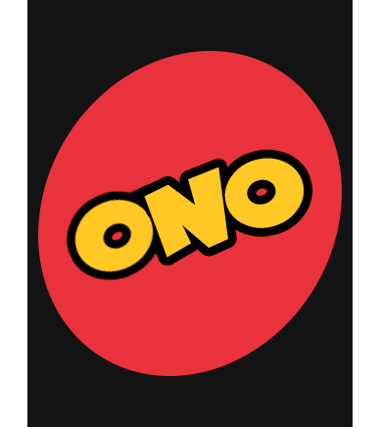
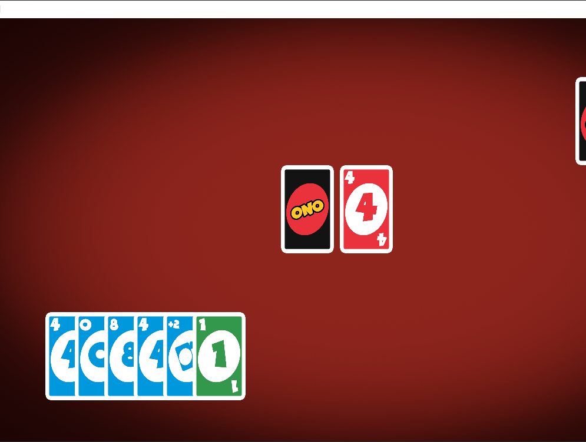
Ono!
Jonathon Qualls

Slide 2
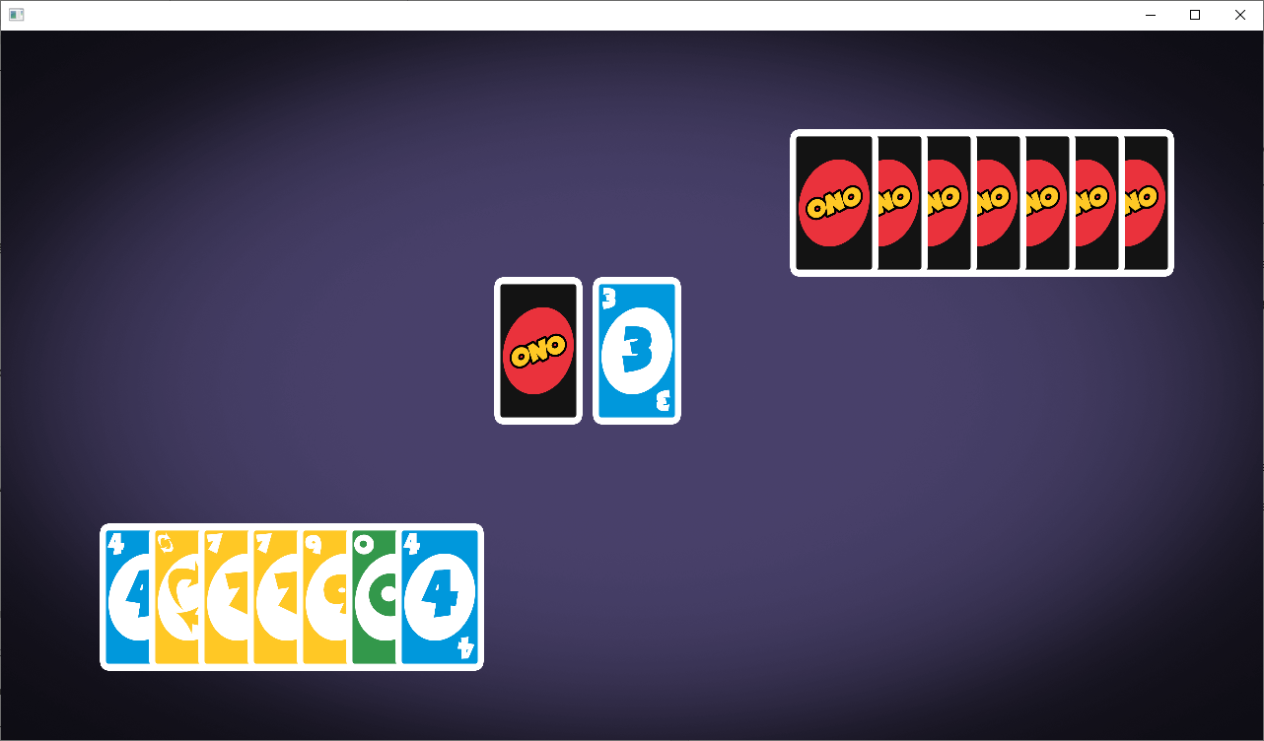
Interesting Things:
End Screens
Random Background
(Red, purple, dark green,
blue light green)
Animation
Color Picker
Play a Card or draw
Empty your hand first
Difficulties:
Dynamic GUI
Animation

Slide 3
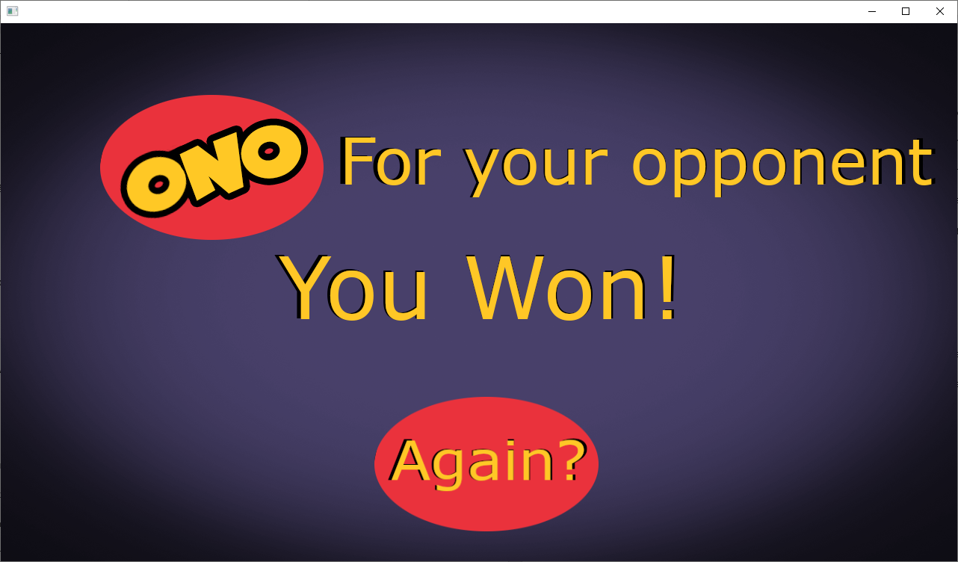

Slide 4
